Slide 1
YLDP TEAM 1 Business Case Presentation
GYB
Trinity – Shouk – Tiana – Chariss – Jocelyne – Heidi – Vallesia

Slide 2
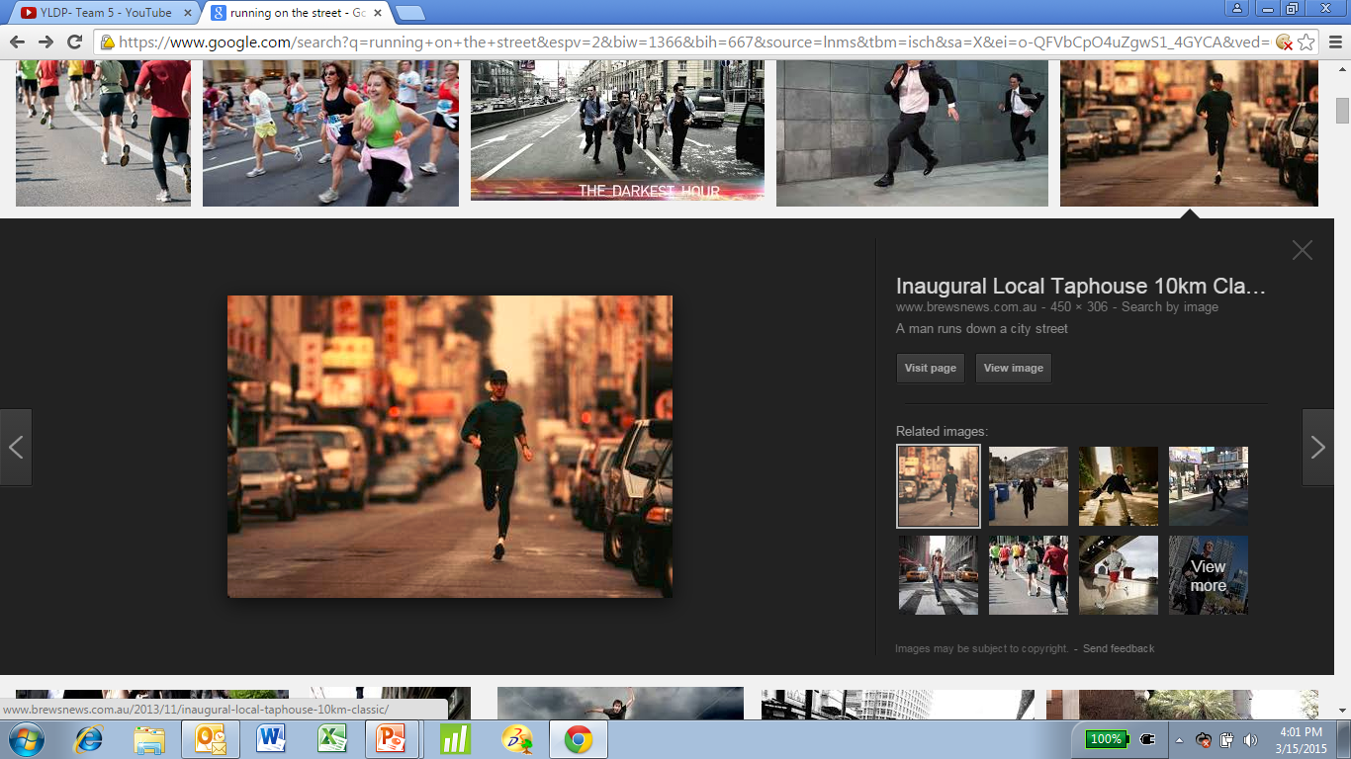
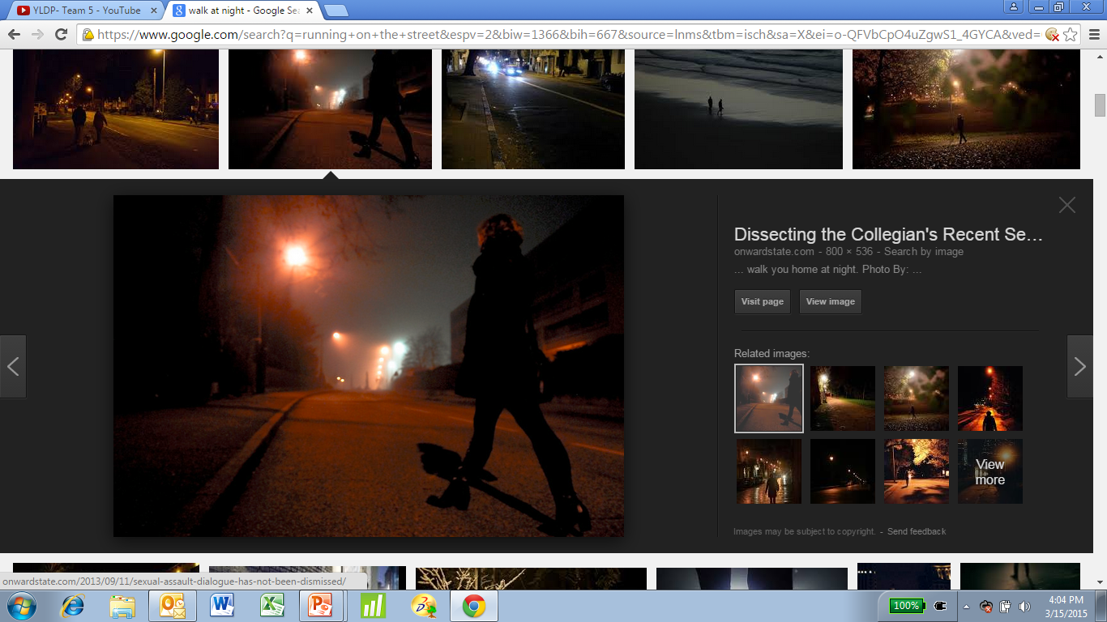
What is the GYB – Product Overview
Ever been scared to walk by yourself at night?
Ever been scared to go running on the street and not know a car is coming?

Slide 3
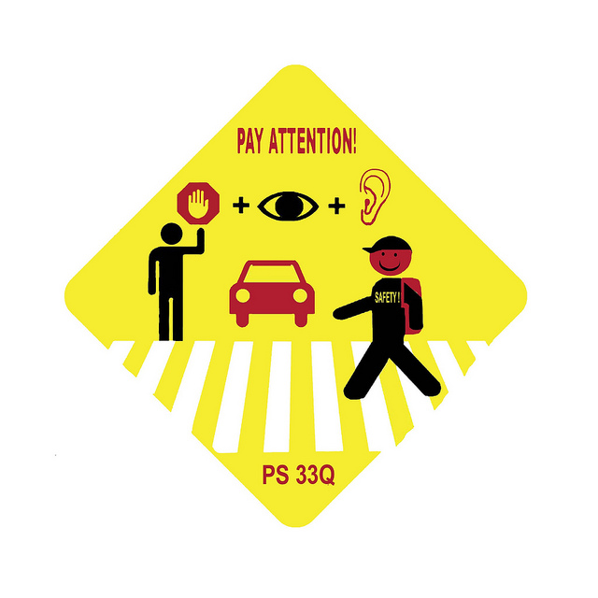
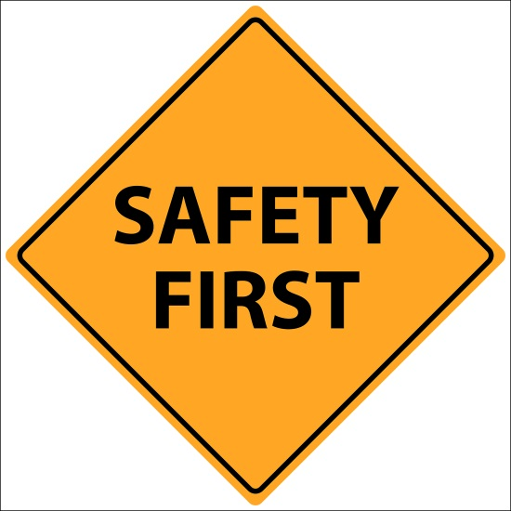
What is the GYB – Product Overview
GYB stands for “Got Your Back”
This watch or bike clip device was built to keep you safe
Whenever you wear it you can go on the street and know if something/someone is approaching you
There is NO product like the GYB currently in the Market

Slide 4
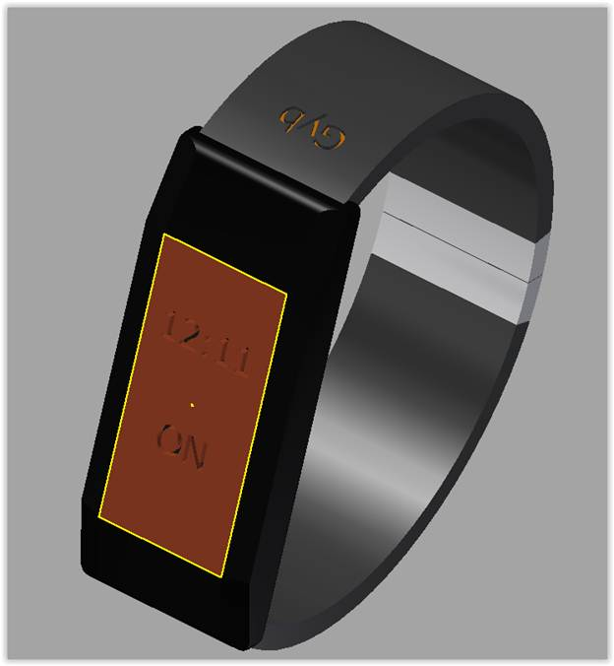
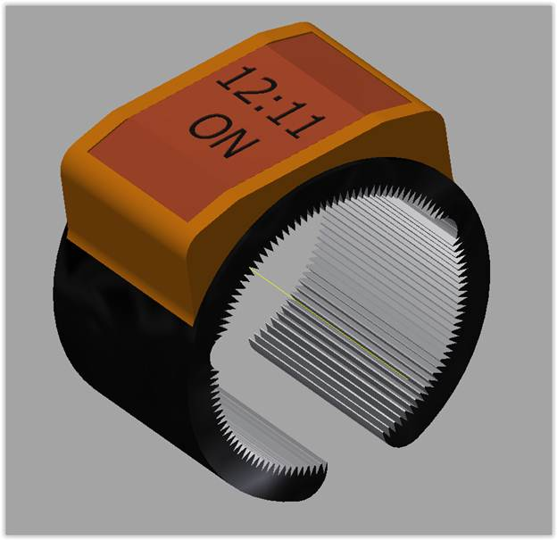
Product Design
Bracelet
Infrared Sensor :
Recognize human movement by detecting incident Infrared Radiation
Motion Sensor and Bluetooth Technology:
To connect to Bluetooth enabled devices for object proximity alarm and statistics tracking
Neoprene Material:
Safe to use next to your skin and should not affect a latex allergy
GYB App and Website:
To sync your device and keep track of your statistics
Bike Clip

Slide 5
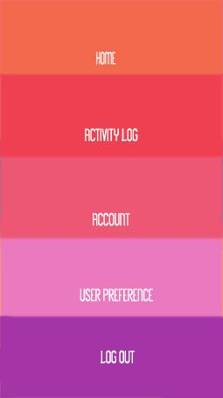
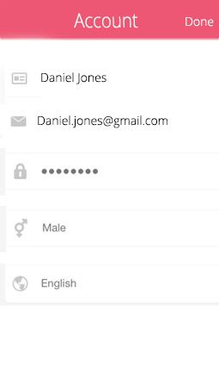
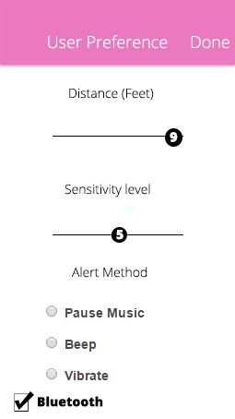
Product Design – GYB App & Website
Settings
Sensitivity Level Adjustability
compare a car, human, or small animal
Distance Alarm Adjustability
measure the amount of feet you want to be alarmed
Alert Method Adjustability
If you want your alarm to vibrate, beep or pause music

Slide 6
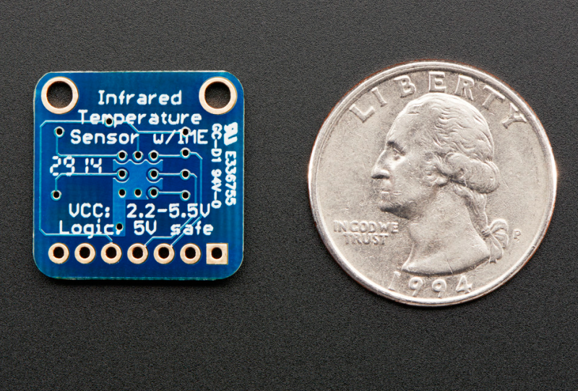
Product Design – Infrared Sensor
Characteristics
Contact-less Infrared Thermopile Sensor Breakout
$12.50 per unit
adafruit.com
Detects disturbances in the infrared spectrum such as person or animal
Recognize human movement by detecting incident Infrared Radiation which varies in proportion to temperature between human body surfaces and surroundings
The sensibility level can be adjusted to ignore multiple small animals

Slide 7
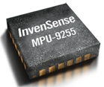
Product Design – Motion Sensor and Bluetooth Technology
Characteristics
Motion Sensor and Bluetooth Technology
$5.37 - $7.22 per unit
invensense.com
First generation 9-axis activity detection part, working in conjunction with the AAR™ activity detection library.
InvenSense ‘AlwaysOn’ low power sensor can detect run, walk, bike, no-motion, and sleep analysis on a wrist worn wearable device.
The enabling force behind the wearable sensor revolution will be ultra-low power wireless connectivity that will transmit data from the wearable device to a phone, tablet, or PC via Bluetooth® smart technology (a lower power version of standard Bluetooth).

Slide 8
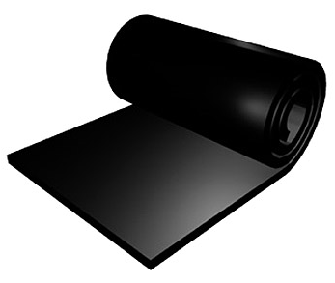
Product Design – Neoprene Material
Characteristics
Image from ewetsuits.com
$35.64 per sheet (1/8”X 50” X80”) which equals 800 bands
Approximately $0.05 per unit
foamorder.com/neoprene.html
NEOPRENE is a synthetic rubber material designed to act flexibly, durably, and to resist breakdown by water
The many uses of Neoprene include: wet suits, waders, insulated can holders, sports gloves, mouse pads, pet collars, elbow and knee pads, orthopedic braces, tack gear
Skin friendly material

Slide 9
Our Competition – Product Overview
Features | GYB | Fitbit | Jawbone
Security
Steps Taken
Distance Traveled
Calories Burned
Sleep Tracker
Alarm
ONLY THE GYB PROVIDES YOU WITH THE SAFETY YOU NEED!

Slide 10
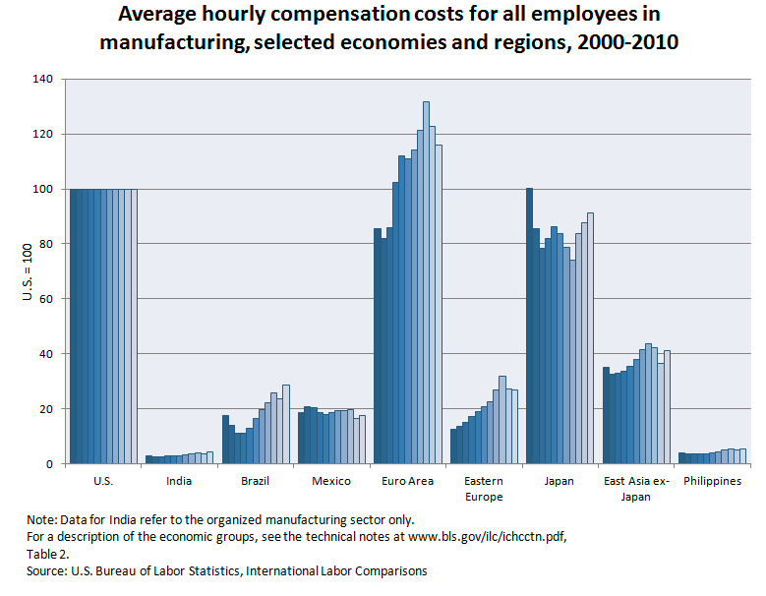
Manufacturing Plan and Cost
Approximate average hourly compensation cost per the US Department of Labor:
India & Phillippines: $5
US: $100
GYB Product Cost
Materials
IR Sensor = $12.50
Neoprene = $0.05
Invense Chip = $5.97
Assembly = $5.00
Total Cost = $23.52
Graph taken from the United States Department of Labor http://www.bls.gov/fls/india.htm#data_features

Slide 11
Marketing Research
Races In The USA
Approximately 1,100 races per year
Approximately 4 major races are held in Jacksonville, FL annually

Slide 12
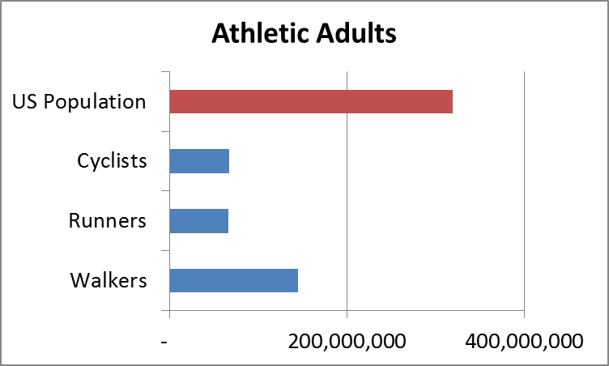
Marketing Research
Target market is people who desire to keep fit
Exercise enthusiast
Walkers, Joggers, Runners and Cyclists
The percentage of people who consider themselves to be athletic is 87% based on the 2014
USA population of 318,900,000.
Target Audience:
Male Runners 18 to 40
Female Runners 16 to 39

Slide 13
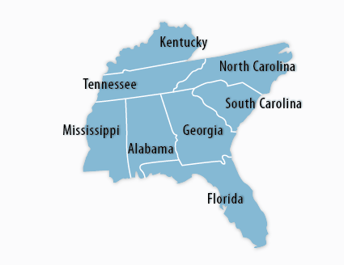
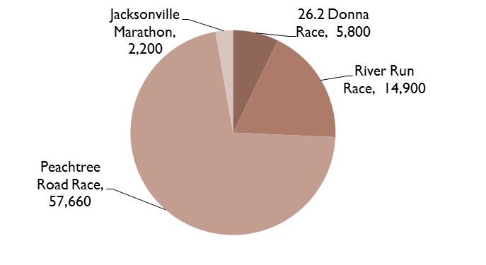
Marketing Plan – 1st year
Florida-Georgia and adjacent states
Race Expos – 5% of participants is 4,028
Race packet flyers - $1,500
TV Commercial - $50,000
Social Media – Facebook Page, Twitter Account, etc
Major Races Around Florida-Georgia
Geographical Area

Slide 14
Marketing Plan – after 1st year
Race Expos – 25% of participants 20,140
Race packet flyers and booths -$2,000
TV Commercial - $50,000
Social Media
Branded Mobile App - $100,000
Magazines - $1,500
Average allocations usually ranges between 9- 12% of the annual budget.
Yahoo homepage- $600,000 for one day
Facebook logout screen- $120,000
Branded mobile app- $100,000 - $150,000
Magazine- (full page) $1,500- $20,000
Television: $50,000- $75,000
Booth sizes- $500- $900

Slide 15
Financials
Year one plan is to sell to Florida and Georgia exclusively
Goal sales: 5% of race participants equaling 2,500 units
Jacksonville Marathon: 2014 Participants 2,200
26.2 Donna Race: 2014 Participants 5,800
River Race: 2014 Participants 14,900
Peachtree Road Race: 2014 Participants 57,600

Slide 16
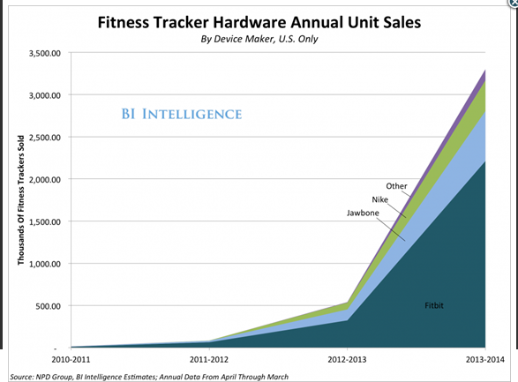
Fitness Tracker Sales
3.3 million fitness trackers were sold between Apr 2013 and Mar 2014 – Business Insider
Unit sales have grown over 500% year over year
Business insider estimates growth will be over 500% next three years

Slide 17
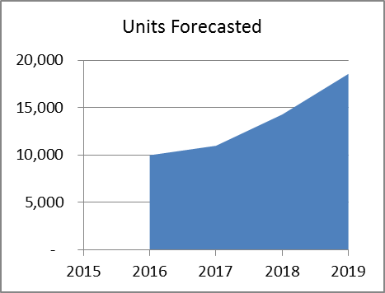
Financial Assumptions
Start selling product on 2016
Cost to manufacture stays constant due to contract agreement with vendors
Average selling price stays constant – it could be increased as popularity increases
Initial Loan - $605,000
Market Curve
Our Units Forecast Curve

Slide 18
Financial Details
Profit after 5 Years (loan paid) = $1,103,070

Slide 19
Summary

Slide 20
Team 1 Lessons Learned
Being on a team is about trusting and counting on each other to do their part
Everything is not going perfect and this experience has really helped me improve my patience
There is no “I” in Team Work
This program has helped set me up for a glimpse of the real world
Stay organized and make sure you have good communication with the ones you are working along side with
The world is filled with unique people and when we come together we create something special

Slide 21
Thank You
To Alejandra, Tier, and Cynthia for guiding us on our journey.
The YLDP program for giving us this opportunity to go through this real life experience.
Vistakon for believing in us!
The video recorder Mr. Antonio for helping us shoot our commercial.
Mark Hogan for the GYB drawing and prototype
Sarah Hudson for help with Finance
The Johnson and Johnson company for giving us something to experience and for giving us a sense of the real life we will be entering in a couple years.

Slide 22

Questions

Slide 24
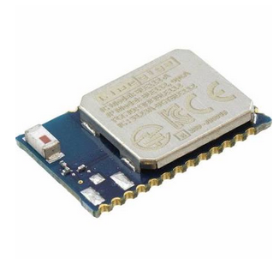
Product Design - Bluetooth Technology
Characteristics
Bluegiga Technologies
$12.77 per unit
bluegiga.com
The key features of Bluetooth technology is that is everywhere, it is low power, and low cost
Bluetooth technology allows you to share voice, data, music, photos, videos and other information wirelessly between paired devices.
According to Bluetooth.com by 2015 approximately 700 million smartphones have Bluetooth capability

Slide 25
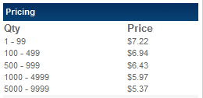
Product Design – MPU-9255
The new MPU-9255 is the company’s first generation 9-axis activity detection part, working in conjunction with the AAR™ activity detection library.
The InvenSense ‘AlwaysOn’ low power sensor can detect run, walk, bike, no-motion, and sleep analysis on a wrist worn wearable device.
This solution is ideal for Smart Watch, Smart Band, and Fitness Tracker applications that want to enable the next generation features for wearable products.

Slide 26

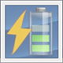
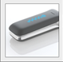
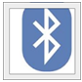
Product Design – MPU-9255
Activity Recognition
This is one of the key underlying technologies required to make these ideas come to life and this is where motion interface plays a critical role.
Power Consumption
In terms of power consumption, it is possible to build thin, light wearable sensor devices that can broadcast data throughout an entire sporting event or record data through an average day
Form Factor
Whether a wearable sensor is a wristwatch, a pod embedded in a shoe, or a device clipped to a belt, it must be comfortable, unobtrusive, and easy to remove.
Wireless Connectivity
The enabling force behind the wearable sensor revolution will be ultra-low power wireless connectivity that will transmit data from the wearable device to a phone, tablet, or PC via Bluetooth® smart technology (a lower power version of standard Bluetooth).

Slide 27
Marketing Expense - Patents
The application filing fee for a basic utility patent is $330, which in addition to a $540 utility patent search fee and a $220 examination fee, plus patent fees of $980 after 3years.
Easily spend $10,000 and $20,000 filing for patents.
Non- provisional patent application involves paying attorney fees between $5,000 and $15,000 or more.
International patents are most expensive running up to $100,000 or higher.

